Slide 1
Real-Time Sentiment Analysis of Twitter
By: AL Faiq Ahamed

Slide 2
Project Scope
The project aims to develop a real-time sentiment analysis system for monitoring Twitter feeds. This system will analyze public sentiment and brand perception across various social media platforms.

Slide 3
Literature Review / Market Study
Research indicates a growing importance of sentiment analysis in understanding consumer behavior and brand reputation. Market trends show an increasing demand for real-time analytics to drive proactive decision-making.

Slide 4
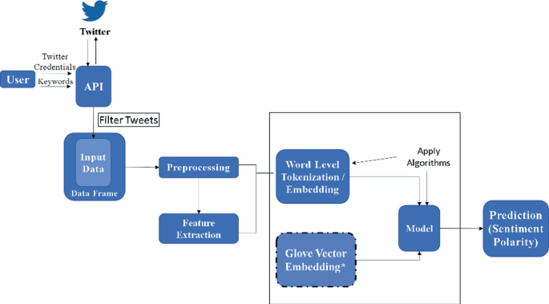
Methodology
1. Data Acquisition: Utilize Twitter API for real-time data ingestion. 2. Data Processing: Implement Spark for streaming data processing and sentiment analysis using NLP techniques. 3. Data Storage: Store analyzed data in Elasticsearch for efficient querying and indexing. 4. Visualization: Use Kibana for real-time visualization of sentiment trends and insights.

Slide 5
Planned Achievements
- Milestone 1 (week 2): Complete setup of data ingestion and initial Spark processing pipeline. - Milestone 2 (week 3): Achieve real-time sentiment analysis and integration with Elasticsearch. - Final Outcome (week 3) : Deliver a functional system with a user-friendly Kibana dashboard for visualizing sentiment trends and insights.

